Slide 1
Spatially Distributed Multi Period Optimal Power Flow with Battery Energy Storage Systems
Aryan Ritwajeet Jha, Graduate Research Assistant¹
Subho Paul, Assistant Professor²
Anamika Dubey, Associate Professor¹
¹ Energy Systems Innovation Center, School of Electrical Engineering and Computer Science, Voiland College of Engineering, Washington State University, Pullman, WA, USA
² Department of Electrical Engineering, Indian Institute of Technology (BHU) Varanasi, Varanasi, UP, India
Notes:
Remember to hit the reset button to make sure all the page elements react properly.
There are 20 different layouts that you can choose from.

Slide 2




Quick Overview of the contents of this presentation
High level overview of a standard OPF problem for Distribution Systems and the MPOPF problem.
Example describing spatial decomposition of the OPF problem (DOPF), and extension to MPDOPF.
Modelling of the MPOPF problem
A comparison of the proposed Spatially Decomposed MPDOPF results vs the Centralized MPCOPF algorithm

Slide 3
OPF, MPOPF, Scalability of the problem

Slide 4
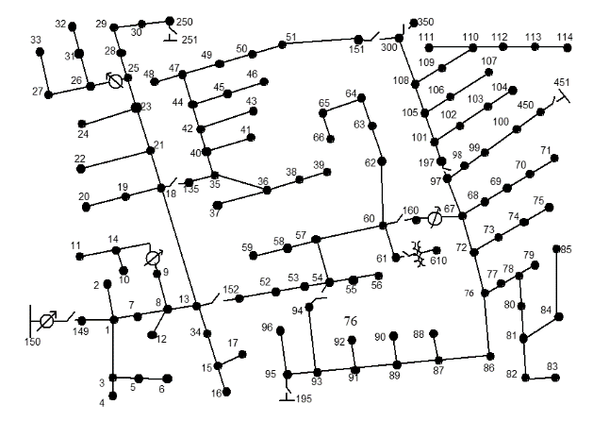
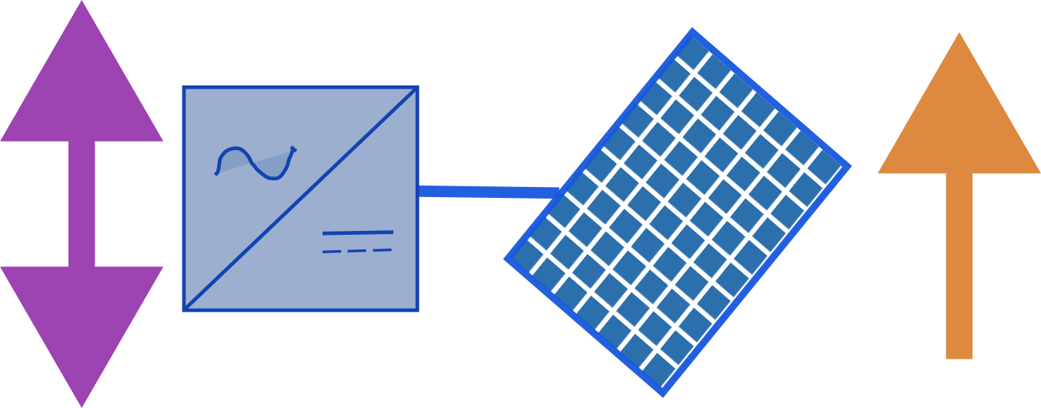



The Optimal Power Flow (OPF) problem for Active Distribution Systems
Optimal?
$min.$Desired Objective Function
$$subject to$$
Network Constraints
Feasible?
Engineering Constraints
Component Constraints (DERs, Batteries)
Power
Substation
Loads and Controllable/Uncontrollable Components spread across a topology

Slide 5
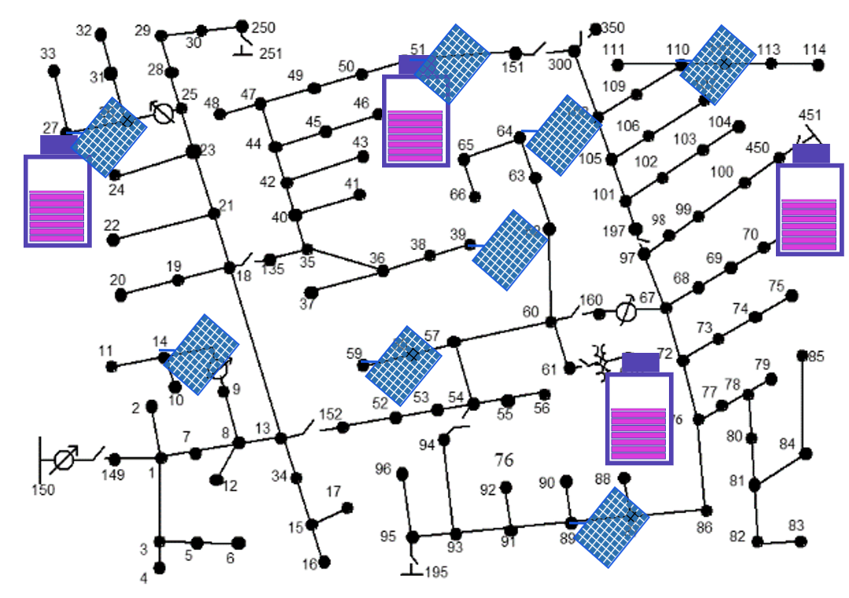
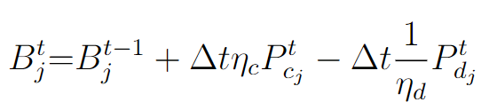
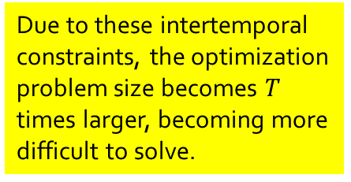
The Multi Period Optimal Power Flow (MPOPF) problem for Active Distribution Systems
Intertemporal Constraints
Intertemporal Constraints
Intertemporal Constraints
Power (t=1)
Power (t=2)
Power (t=3)
Due to these intertemporal constraints, the optimization problem size becomes $T$ times larger, becoming more difficult to solve.
Intertemporal Constraints
Battery SOC Equation
An example of
is

Slide 6
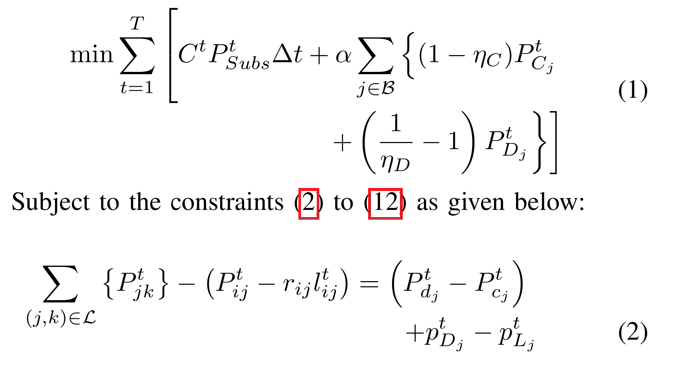
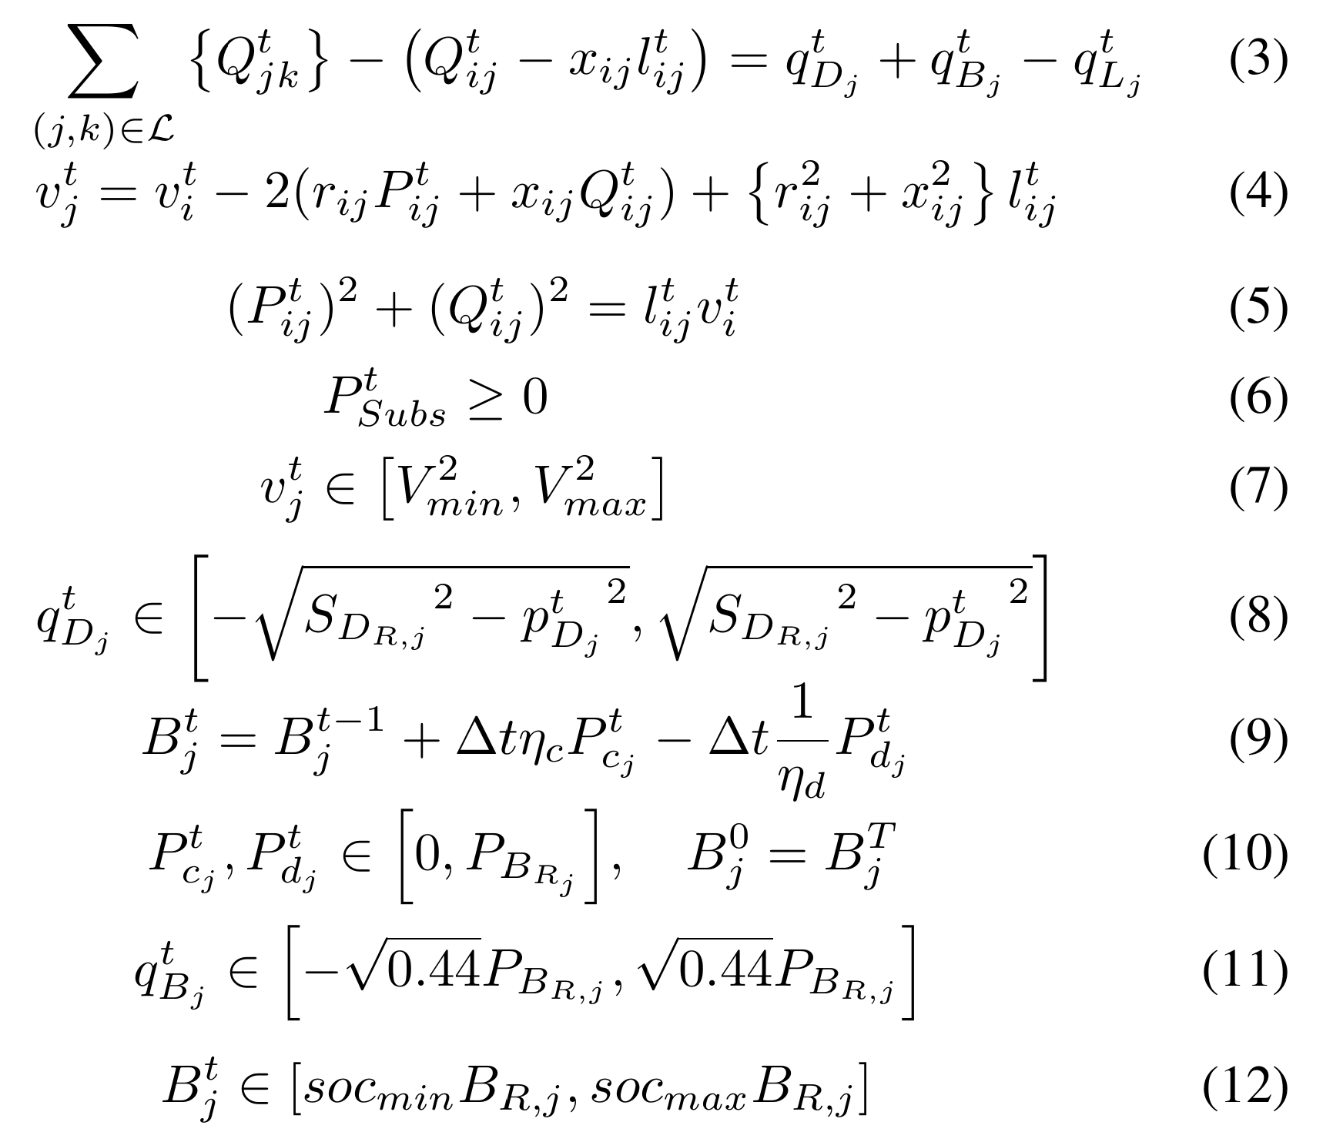
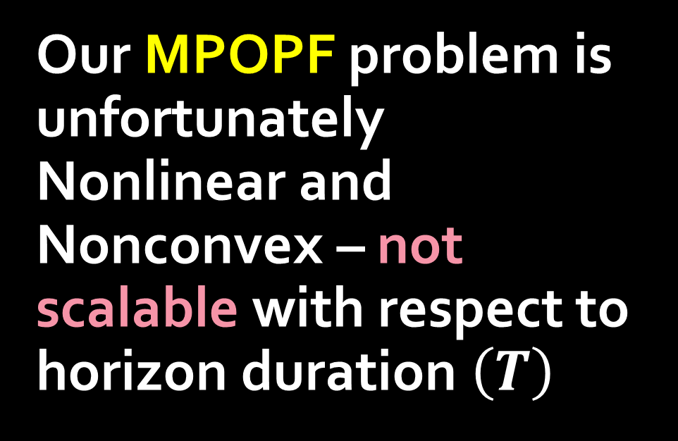
Our MPOPF problem is unfortunately Nonlinear and Nonconvex – not scalable with respect to horizon duration $\left(T\right)$
Model to be explained in a few slides ..
Our proposed algorithm achieves the same objective function values as traditional methods in a fraction of the time, without using additional approximations or relaxations

Slide 7
Spatially Decomposing the MPOPF Problem

Slide 8
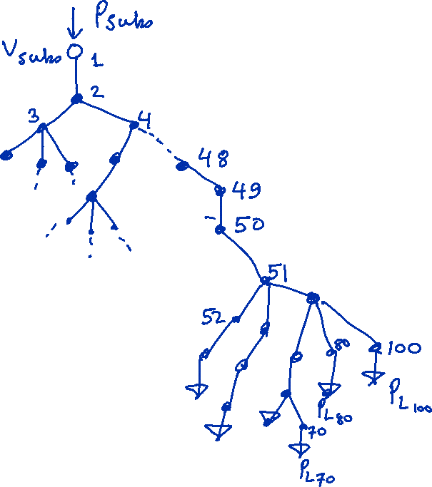
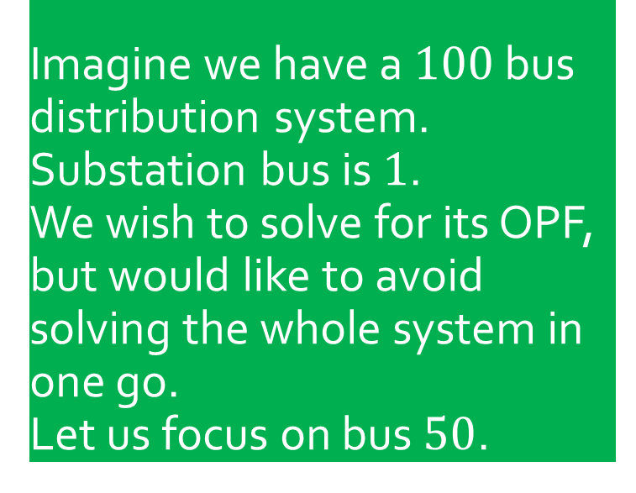
Intuition for Spatial Decomposition
Imagine we have a $100$ bus distribution system. Substation bus is $1$.
We wish to solve for its OPF, but would like to avoid solving the whole system in one go. Let us focus on bus $50$.

Slide 9
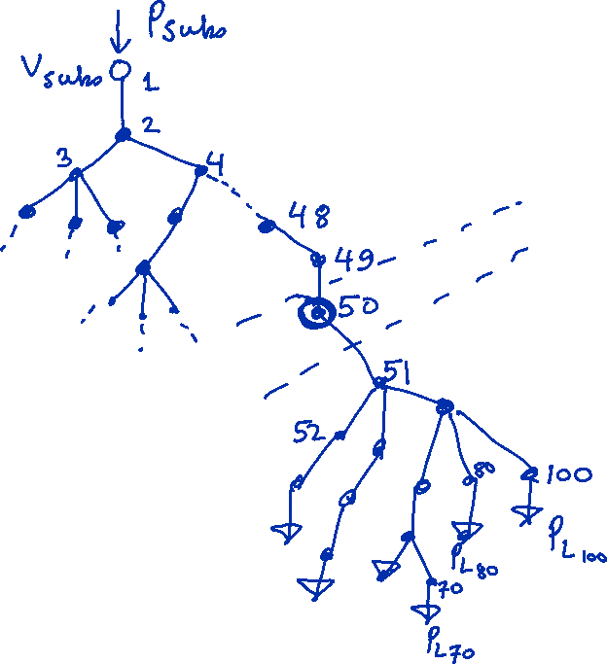
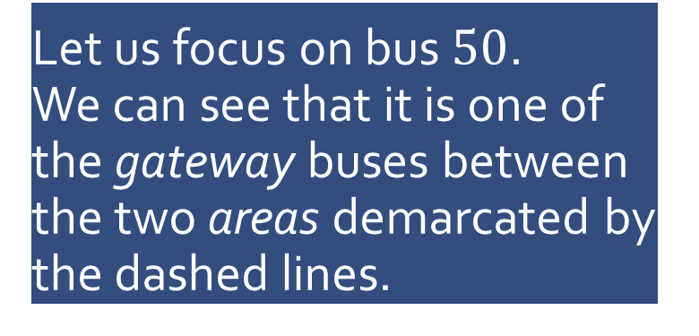
Intuition for Spatial Decomposition
Let us focus on bus $50$.
We can see that it is one of the gateway buses between the two areas demarcated by the dashed lines.

Slide 10
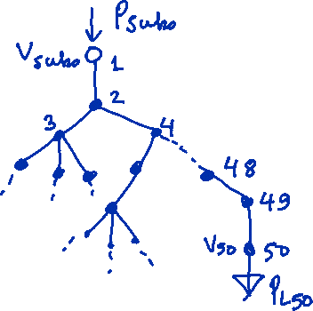
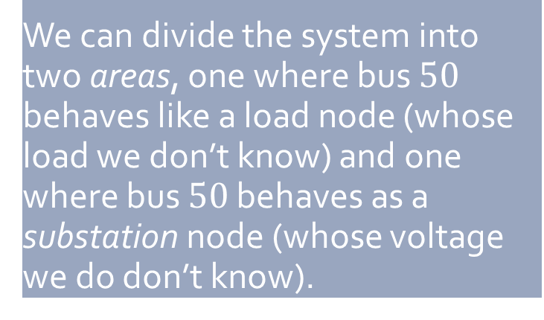
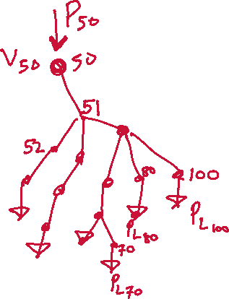
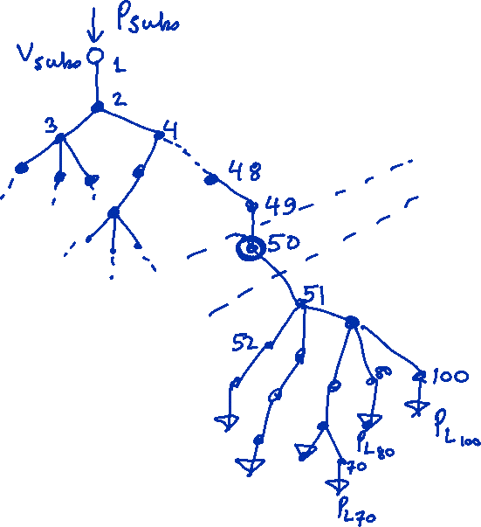
Intuition for Spatial Decomposition
Now we have two OPF problems, each of half the size (and less than half the computation time) of the original problem
We can divide the system into two areas, one where bus $50$ behaves like a load node (whose load we don’t know) and one where bus $50$ behaves as a substation node (whose voltage we do don’t know).

Slide 11

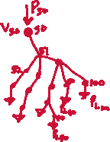
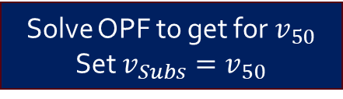
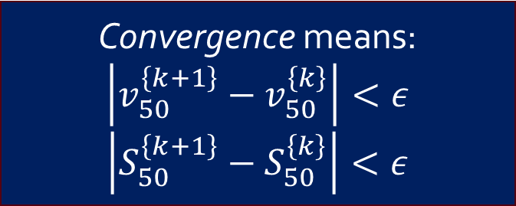
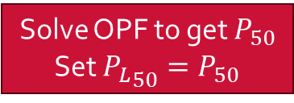
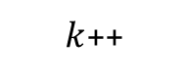
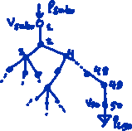


Start
We call this process DOPF where D stands for Spatially Distributed/Decomposed
Intuition for Spatial Decomposition
Each macro-iteration ($k)$:
Refer to [1] for details
Convergence means:
$$\left|v_{50}^{\left\{k+1\right\}}−v_{50}^{\left\{k\right\}}\right|<ε$$
$$\left|S_{50}^{\left\{k+1\right\}}−S_{50}^{\left\{k\right\}}\right|<ε$$
Area $1$
$k$++
Solve OPF to get for $v_{50}$
Set $v_{Subs}=v_{50}$
Solve OPF to get $P_{50}$
Set ${P_{L}}_{50}=P_{50}$
Exchange boundary variables, and continue.
Area $2$
No
Yes
Are boundary variables converged?
Stop

Slide 12

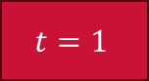

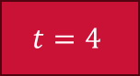
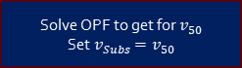
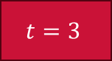
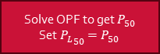
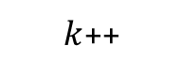


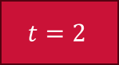

Start
Intuition for Spatial Decomposition
We call this process MPDOPF
Each macro-iteration ($k)$:
$k$++
Area $1$
Solve OPF to get for $v_{50}$
Set $v_{Subs}=v_{50}$
Solve OPF to get $P_{50}$
Set ${P_{L}}_{50}=P_{50}$
Exchange boundary variables, and continue.
Area $2$
$$t=1$$
$$t=2$$
$$t=3$$
$$t=4$$
No
Are boundary variables converged?
Stop
Yes

Slide 13
Modelling of our MPOPF problem

Slide 14
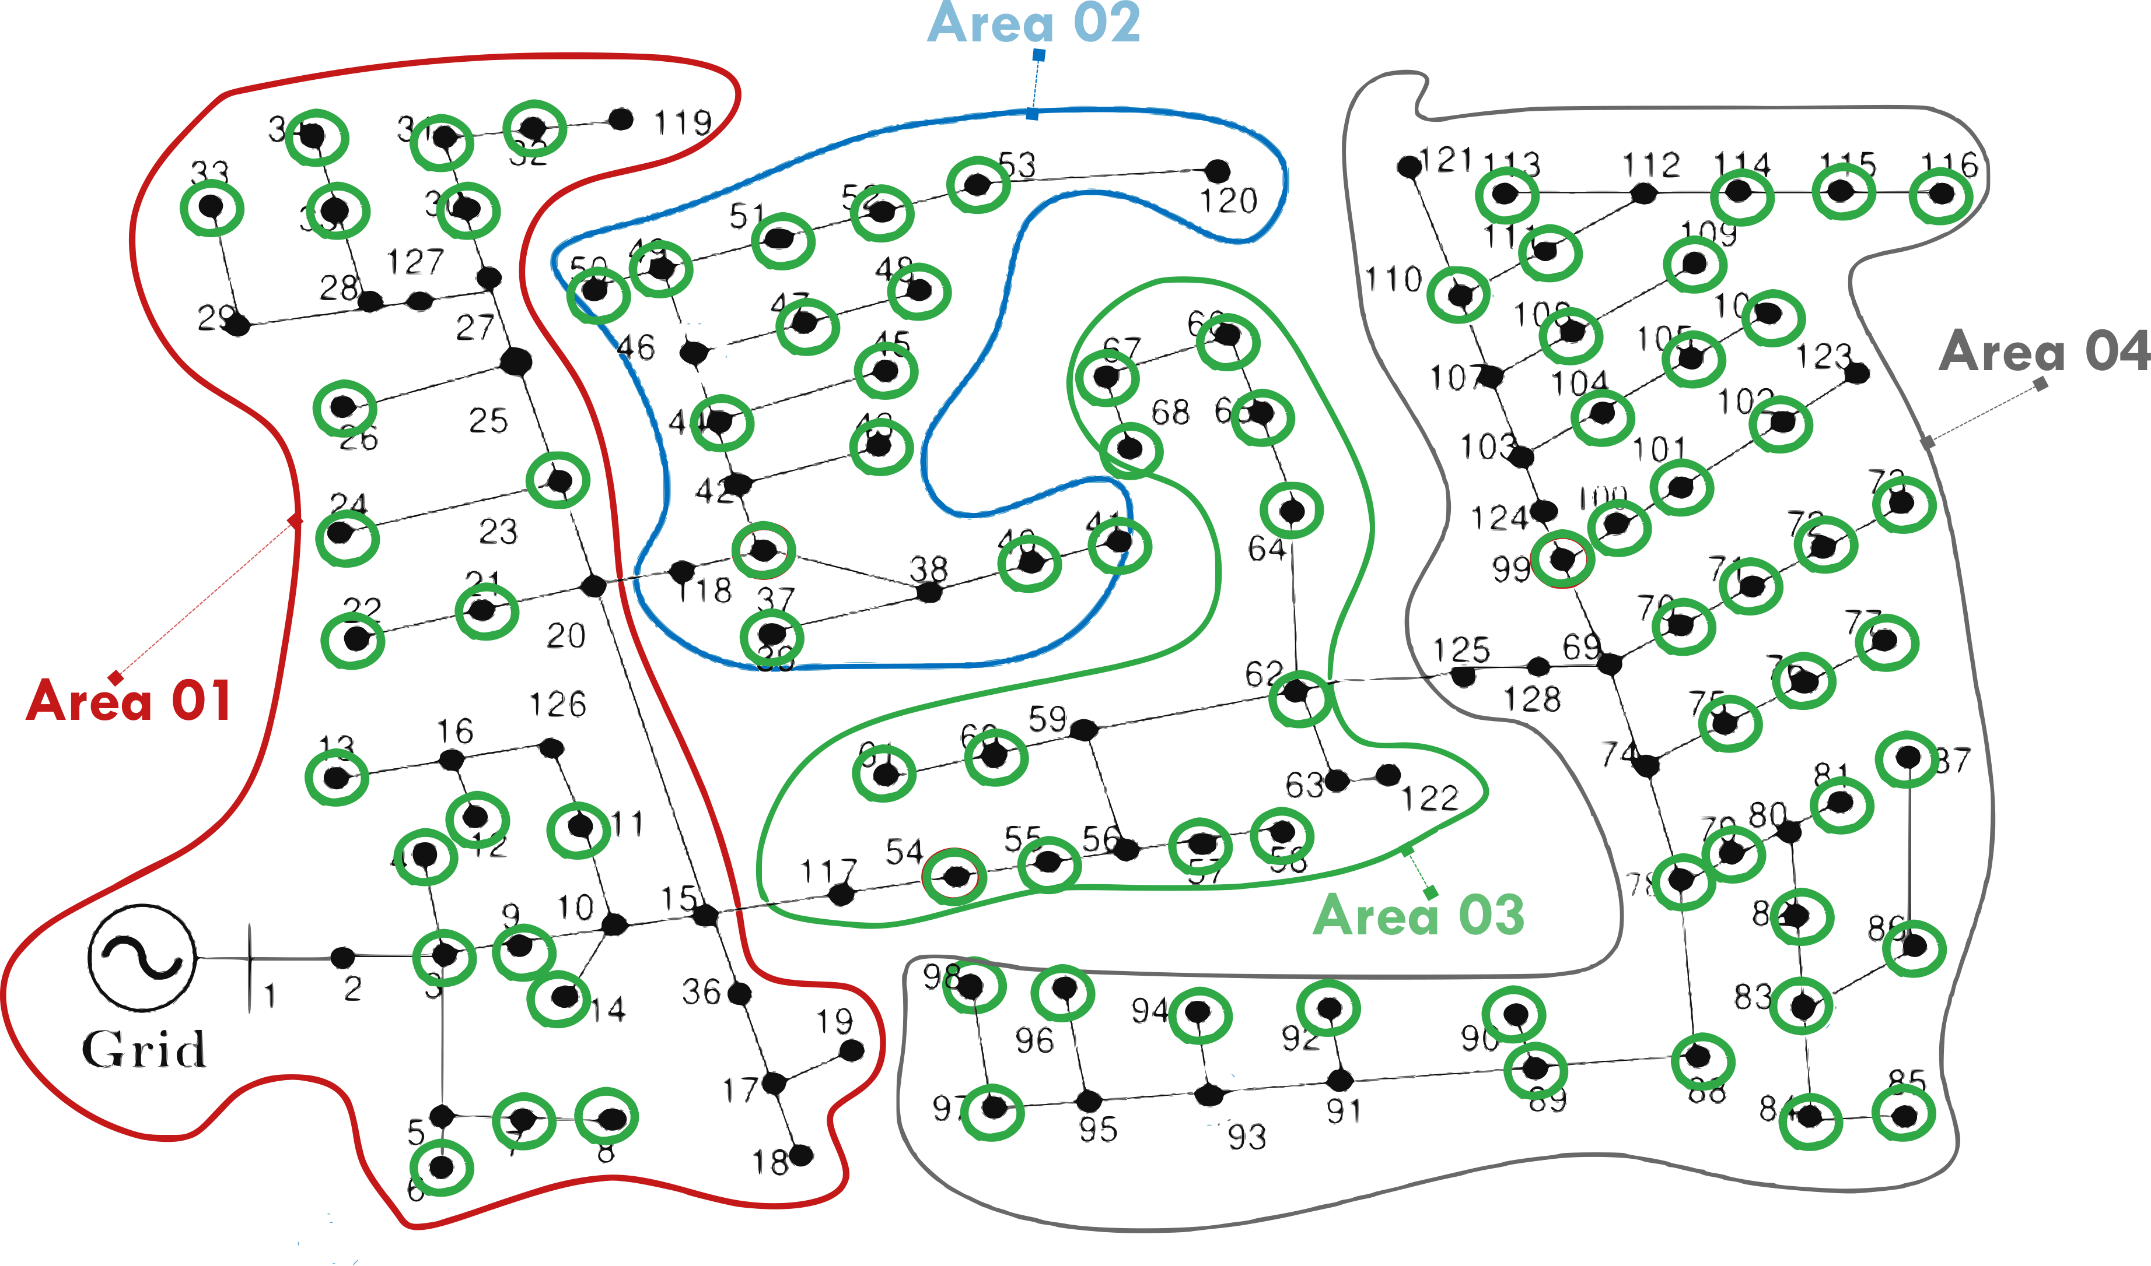

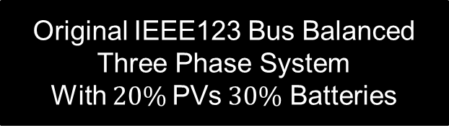
Network Topology and Decomposition
Original IEEE123 Bus Balanced Three Phase System
With $20\%$PVs$30\%$ Batteries
Same system but Decomposed into four areas for performing MPDOPF

Slide 15
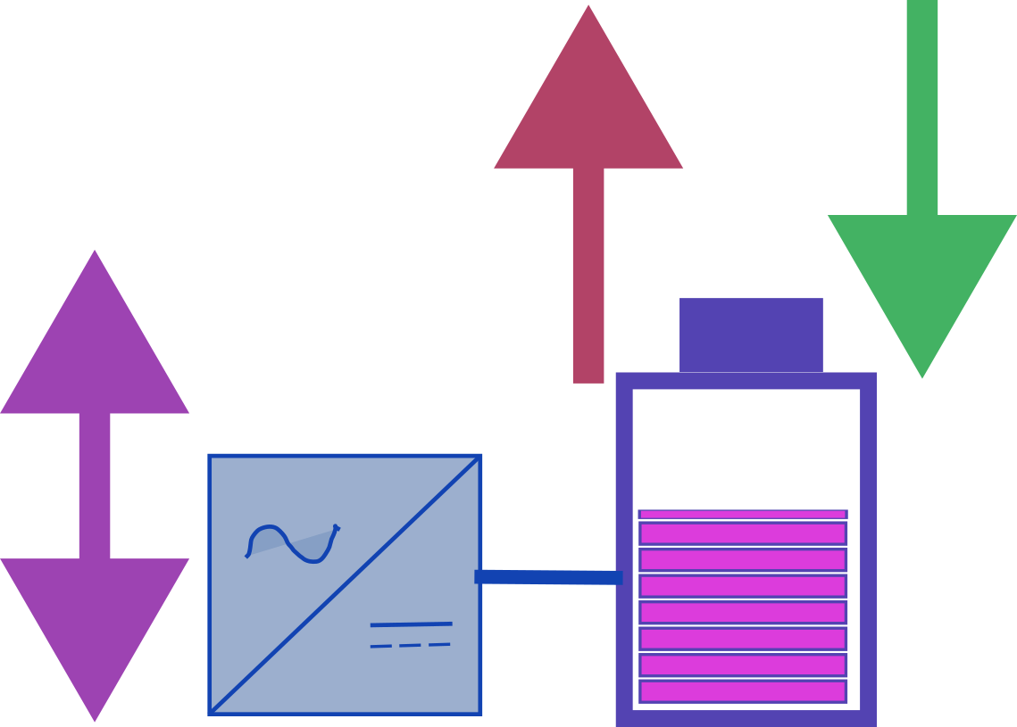

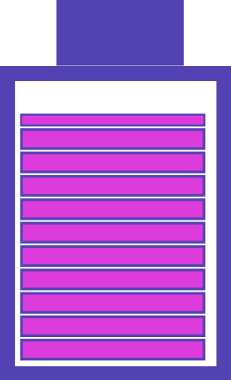
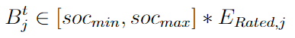
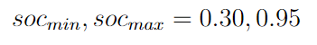
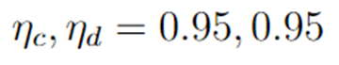
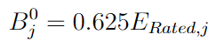
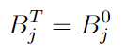
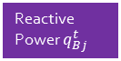
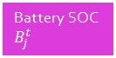






Modelling of Battery with Inverter
Note: Values here are typical in OPF literature [2, 3]
Discharging Power $P_{dj}^{t}$
Charging Power $P_{cj}^{t}$
Battery SOC Equation
Reactive Power $q_{Bj}^{t}$
Battery SOC $B_{j}^{t}$
Inverter Rating ${S_{Rated}}_{j}$
$$∈($$
$$,$$
$$)$$
Battery SOC Limits
Battery SOC Limits
Battery SOC Limits
Charging/Discharging Efficiencies
Initial SOC
After full horizon:
Terminal SOC constraint

Slide 16
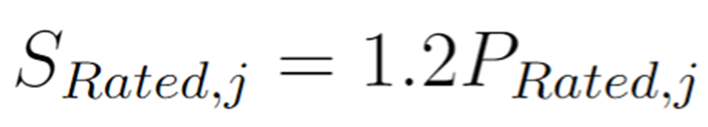
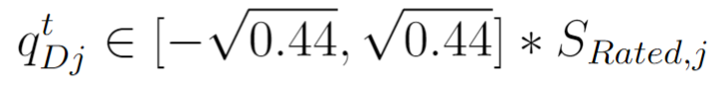
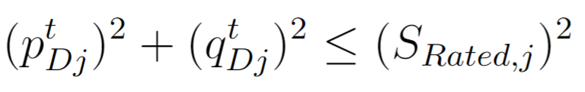





Solar PVs with Inverters
PV Real Power $P_{Dj}^{t}$
Reactive Power $q_{Dj}^{t}$
Inverter Rating ${S_{Rated}}_{j}$
Relationships between the rated powers
Typical $P_{Ratedj}∈\left[5, 40\right]$ kW
Typically, $P_{Ratedj}=\frac{1}{3}∗P_{Loadj}$
Typical $q_{Ratedj}∈\left[1, 10\right]$ kVAr
Typically, $q_{Ratedj}=\frac{1}{3}∗Q_{Loadj}$
Solar Inverter Rating Limit

Slide 17
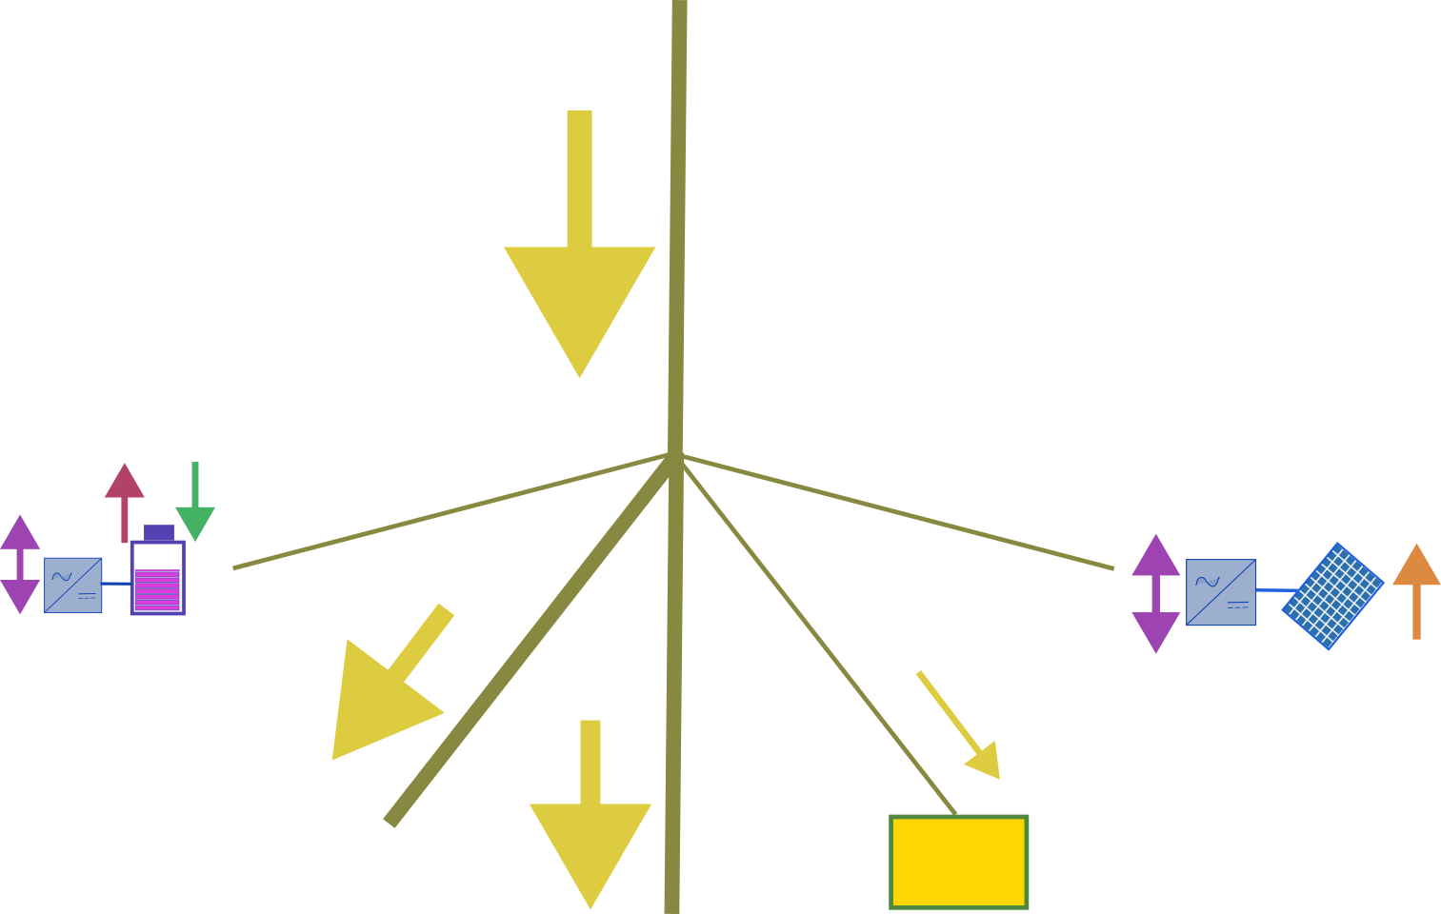
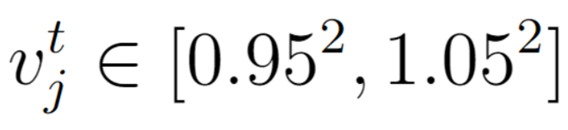
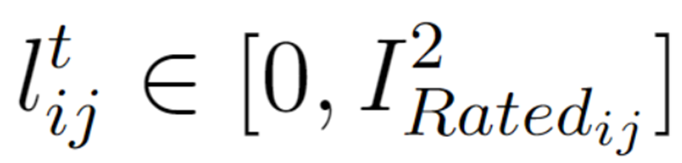
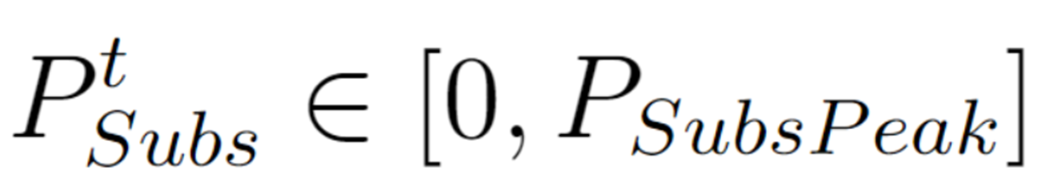







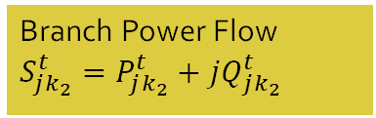
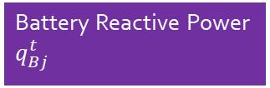






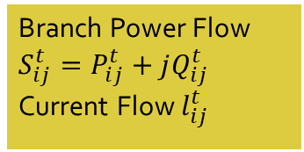
Bus $i$:$v_{i}^{t}={\left(V_{i}^{t}\right)}^{2}$
Network Constraints – Branch Flow Model [1A
Branch Power Flow $S_{ij}^{t}=P_{ij}^{t}+jQ_{ij}^{t}$
Current Flow $l_{ij}^{t}$
Branch $(i, j)$
Discharging Power $P_{dj}^{t}$
Charging Power $P_{cj}^{t}$
Bus $j$:$v_{j}^{t}={\left(V_{j}^{t}\right)}^{2}$
PV Real Power $P_{Dj}^{t}$
Battery Reactive Power $q_{Bj}^{t}$
Branch $(j, k_{1})$
Branch $(j, k_{2})$
PV Reactive Power $q_{Dj}^{t}$
Bus $k_{1}$
Engineering Constraints
Branch Power Flow $S_{jk_{1}}^{t}=P_{jk_{1}}^{t}+jQ_{jk_{1}}^{t}$
Bus $k_{2}$
Load $P_{Lj}^{t}+jQ_{Lj}^{t}$
Branch Power Flow $S_{jk_{2}}^{t}=P_{jk_{2}}^{t}+jQ_{jk_{2}}^{t}$
No backflow allowed
Optionally, Peak Satisfiable Demand may be specified as well

Slide 18



























Bus $i$:$v_{i}^{t}={\left(V_{i}^{t}\right)}^{2}$
Network Constraints – Branch Flow Model [1A]
Branch Power Flow $S_{ij}^{t}=P_{ij}^{t}+jQ_{ij}^{t}$
Current Flow $l_{ij}^{t}$
Branch $(i, j)$
Discharging Power $P_{dj}^{t}$
Charging Power $P_{cj}^{t}$
Bus $j$:$v_{j}^{t}={\left(V_{j}^{t}\right)}^{2}$
Node $j$ Real Power Balance
PV Real Power $P_{Dj}^{t}$
Battery Reactive Power $q_{Bj}^{t}$
Branch $(j, k_{1})$
Branch $(j, k_{2})$
PV Reactive Power $q_{Dj}^{t}$
Node $j$ Reactive Power Balance
Bus $k_{1}$
Branch Power Flow $S_{jk_{1}}^{t}=P_{jk_{1}}^{t}+jQ_{jk_{1}}^{t}$
Bus $k_{2}$
Load $P_{Lj}^{t}+jQ_{Lj}^{t}$
Branch Power Flow $S_{jk_{2}}^{t}=P_{jk_{2}}^{t}+jQ_{jk_{2}}^{t}$
KVL across branch $(i, j)$
Net Generation at Node $j$
Current Magnitude across branch $(i, j)$

Slide 19


Bus $i$:$v_{i}^{t}={\left(V_{i}^{t}\right)}^{2}$
Full Optimization Model – Balanced Three-Phase Nonlinear OPF
Branch Power Flow $S_{ij}^{t}=P_{ij}^{t}+jQ_{ij}^{t}$
Current Flow $l_{ij}^{t}$
Branch $(i, j)$
Discharging Power $P_{dj}^{t}$
Charging Power $P_{cj}^{t}$
Bus $j$:$v_{j}^{t}={\left(V_{j}^{t}\right)}^{2}$
PV Real Power $P_{Dj}^{t}$
$min.$Desired Objective Function, (appended with an Battery Loss Function) [4]
Battery Reactive Power $q_{Bj}^{t}$
Branch $(j, k_{1})$
Branch $(j, k_{2})$
PV Reactive Power $q_{Dj}^{t}$
$$subject to$$
Bus $k_{1}$
Network Constraints
Branch Power Flow $S_{jk_{1}}^{t}=P_{jk_{1}}^{t}+jQ_{jk_{1}}^{t}$
Bus $k_{2}$
Load $P_{Lj}^{t}+jQ_{Lj}^{t}$
Engineering Constraints
Branch Power Flow $S_{jk_{2}}^{t}=P_{jk_{2}}^{t}+jQ_{jk_{2}}^{t}$
Component Constraints (DERs, Batteries)

Slide 20
Results and Insights

Slide 21



Comparison between MPCOPF and MPDOPF for $T=5$
Smaller Problem Size
Same Converged Objective Value
Decision Variables could be different
Appreciable Computation Speedup ($10$times) !
Result: Proposed MPDOPF Method cuts down the computational complexity of the MPOPF problem, making way for faster solution!

Slide 22


Checking MPDOPF Solution to see if it makes sense
Forecasted timeseries
Optimal Battery Actions
Battery Dispatch Pattern Intutively tracks the cost curve for substation power. It charges up when cost is low, and discharges (injects power into the grid) when cost if higher
Complementarity of Charging and Discharging Operations ensured despite lack of Integer Constraint Modelling
Battery SOCs coming back to their original SOC values at the end of the horizon

Slide 23


Comparison between MPCOPF and MPDOPF for $T=10$
Smaller Problem Size
Same Converged Objective Value
Decision Variables could be different
Appreciable Computation Speedup ($10$times) !
Result: Proposed MPDOPF Method cuts down the computational complexity of the MPOPF problem, making way for faster solution!

Slide 24





Review and Conclusions
MPOPF Problem (unrelaxed, unapproximated) can be hard to solve.
By Spatially Decomposing the system into smaller connected areas and solving for the MPOPF for each area in an iterative exchange manner, we can cut down the problem size and solving time.
But this does not truly solve the MPOPF problem, as in it also will not scale up for bigger horizon times (say, $T=96$ for a medium system like IEEE$123$).
Currently we’re working on development and testing of an algorithm which will both spatially and temporally decompose the MPOPF problem, making it scalable.

Slide 25



Thank You.
Aryan Ritwajeet Jha
aryan.jha@wsu.edu
Pursuing PhD ECE at Washington State University
LinkedIn

Slide 26

Appendix and References follow

Slide 27
References
[1] Sadnan, R., & Dubey, A. (2021). Distributed Optimization Using Reduced Network Equivalents for Radial Power Distribution Systems. IEEE Trans. Power Syst., 36(4), 3645–3656. doi: 10.1109/TPWRS.2020.3049135
[1A] Farivar, M., & Low, S. H. (2012). Branch Flow Model: Relaxations and Convexification (Parts I, II). arXiv, 1204.4865. Retrieved from https://arxiv.org/abs/1204.4865v4
[2] Eilyan Bitar's Papers. (2023, August 16). Coordinated Aggregation
of Distributed Demand-Side Resources. Retrieved from https://bitar.engineering.cornell.edu/papers.html
[3] Pandey, A., Agarwal, A., & Pileggi, L. (2020). Incremental Model Building Homotopy Approach for Solving Exact AC-Constrained Optimal Power Flow. arXiv, 2011.00587. Retrieved from https://arxiv.org/abs/2011.00587v1

Slide 28
References
[4] Nazir, N., & Almassalkhi, M. (2021). Guaranteeing a Physically Realizable Battery Dispatch Without Charge-Discharge Complementarity Constraints. IEEE Trans. Smart Grid, 14(3), 2473–2476. doi: 10.1109/TSG.2021.3109805
[5] MultiPeriod-DistOPF-Benchmark. (2024, July 20). Retrieved from https://github.com/Realife-Brahmin/MultiPeriod-DistOPF-Benchmark

